Slide 1
Increasing Gun Violence in the United States
Team Apollo
Members : Arindam Mukherjee, Cesar Marquez, Raghavendra Gundachar, Sandeep Dasgupta

Slide 2
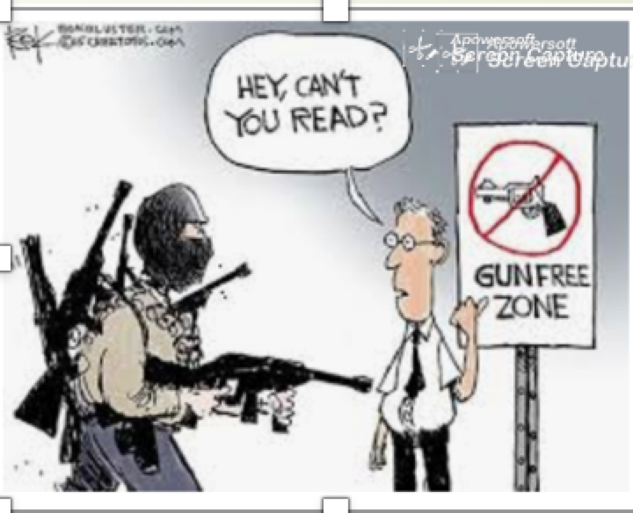
Key Facts about Gun Crimes
United States has the highest gun ownership rate in the world - an average of 88 per 100 people. That puts her at the top in the world for gun ownership - and even the number two country, Yemen, has significantly fewer - 54.8 per 100 people
But the US does not have the worst firearm murder rate - that prize belongs to Honduras, El Salvador and Jamaica. In fact, the US is number 28, with a rate of 2.97 per 100,000 people
Puerto Rico tops the world’s table for firearms murders as a percentage of all homicides - 94.8%. It’s followed by Sierra Leone in Africa and Saint Kitts and Nevis in the Caribbean
Reference : https://www.theguardian.com/news/datablog/2012/jul/22/gun-homicides-ownership-world-list

Slide 3

Incidents , Casualties, Most Violent States/Cities, Participating Age Groups
Notes:
Gun Violence has been a huge topic the past few years in the U.S We believed this was a good topic to discuss because it seemed to have no resolution and that through our vizualations we would be able to understand the reasoning behind why this topic has been constantly on the News.
The group members on my time travel a lot and usually travel with their family, therefore going to a relatively safe state and or city when ever traveling is always on the checklist when making vacation plans.

Slide 4
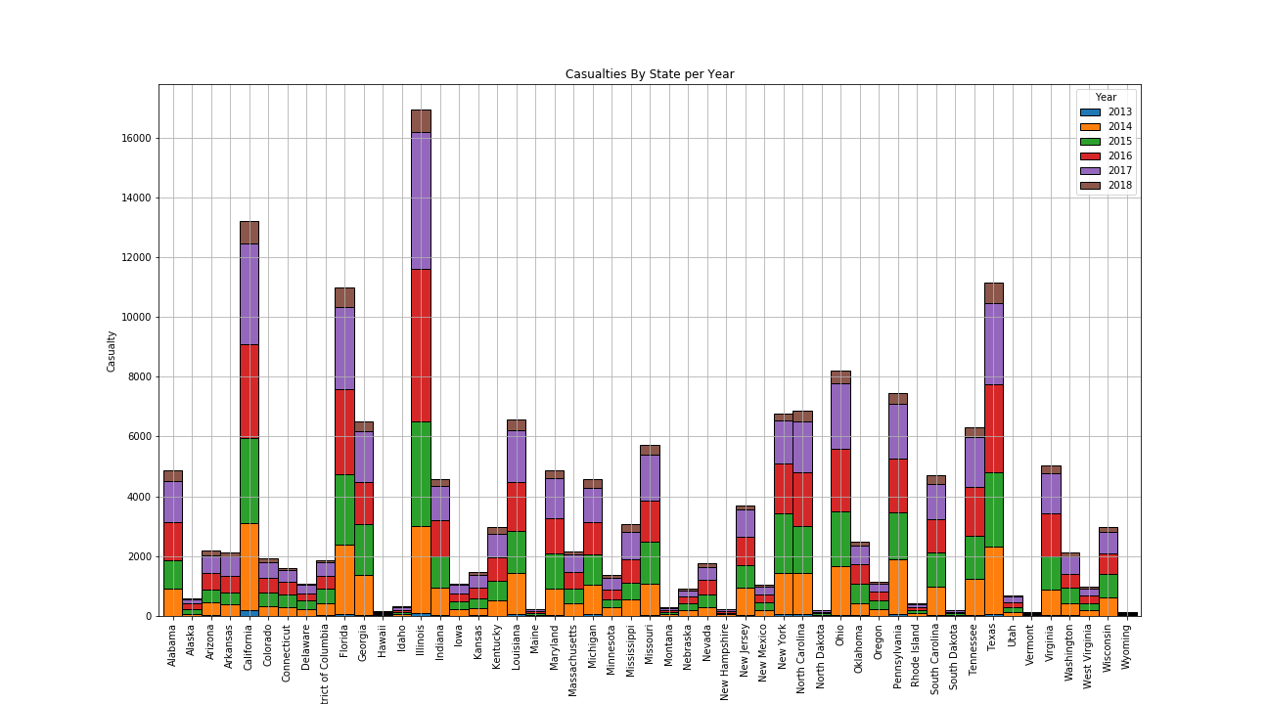
State-wise Crime Rate
Illinois-highest casualty/Incidents.
Wyoming -lowest casualty/Incidents.
Notes:
This graph shows the casualty by state for every year of data that we acquired. By looking at this graph you can see that the casualty count is highest in Illinois. The graph also shows the casualty count in Wyoming to be the lowest in the united states. One of the reasons we believe that Wyoming is lowest in the United States is because of it’s smaller population and rural lifestyle. There are many reasons we believe Illinois casualties count is so high, one of them being racial inequality and segregation. Lack of resources and opportunities often lead young people in poor communities to turn to violence, community leaders and gun regulation advocates tell Axios. This is evident in the 12 poor, minority neighborhoods which account for 50% of Chicago's shootings — often attributed to gang activity — according to a study by Northwestern University.

Slide 5
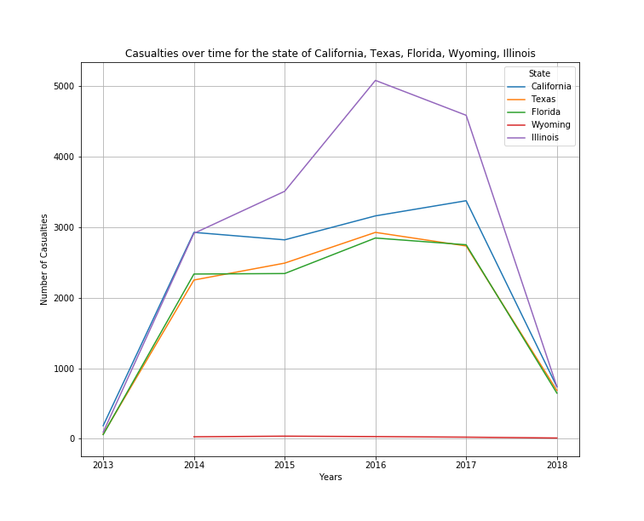
US States Casualty Trend Comparisons
Interactive line graph.
Increasing incidents & casualties every year
Note 2018 only includes first quarter
Notes:
This particular graph shows the Casualty trend for 5 specific states. As you can see Illinois casualty trend has increased throughout the years. The reason is drops in 2018 is because the data for 2018 only includes up to March of 2018. This graph is perfect for comparing the casualty trend of different states because you can visually see the high and lowest points of a particular state. In our code this is an interactive graph, you are able to select any number of states and it will create a line graph for the particular states that you have inputted.

Slide 6
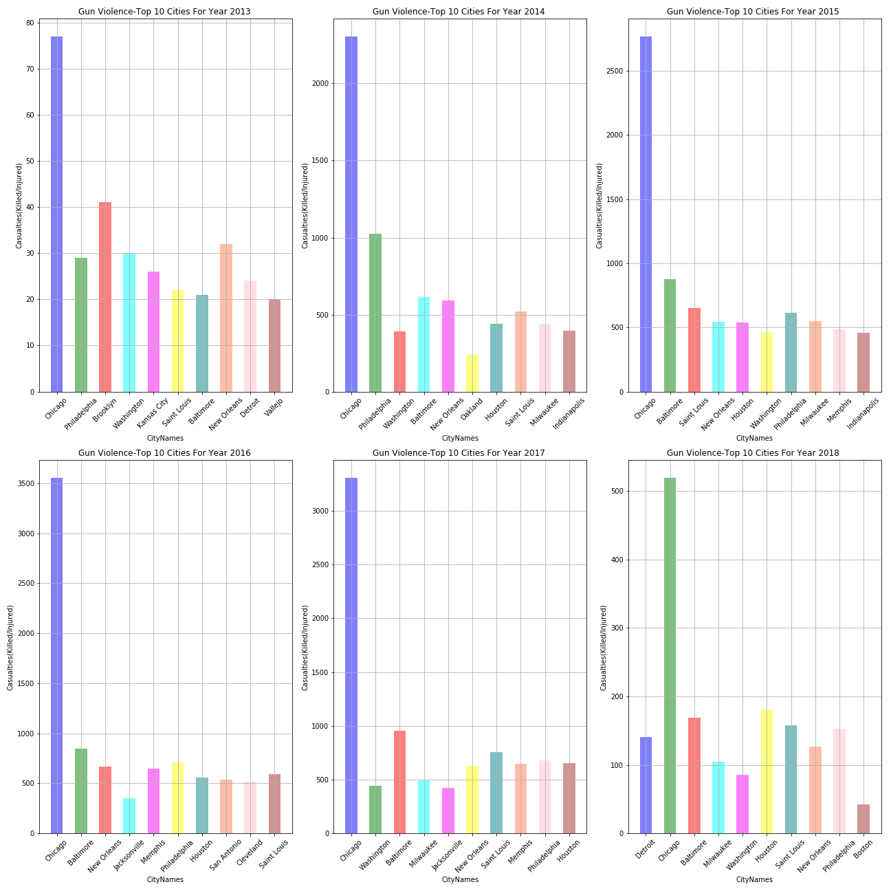
Top 10 Cities with Highest Casualties per Year (2013-2018)
Chicago-highest incidents/casualties every year.
***Third Last slide shows a comparative chart for the above 6 Graphs combined as a whole
Notes:
This visualization shows casualty amounts for the top 10 cities in the united states for each year. For each year as you can see Chicago always appears in the top cities. Knowing this would explain why Illinois is the highest casualty state based on our data.

Slide 7
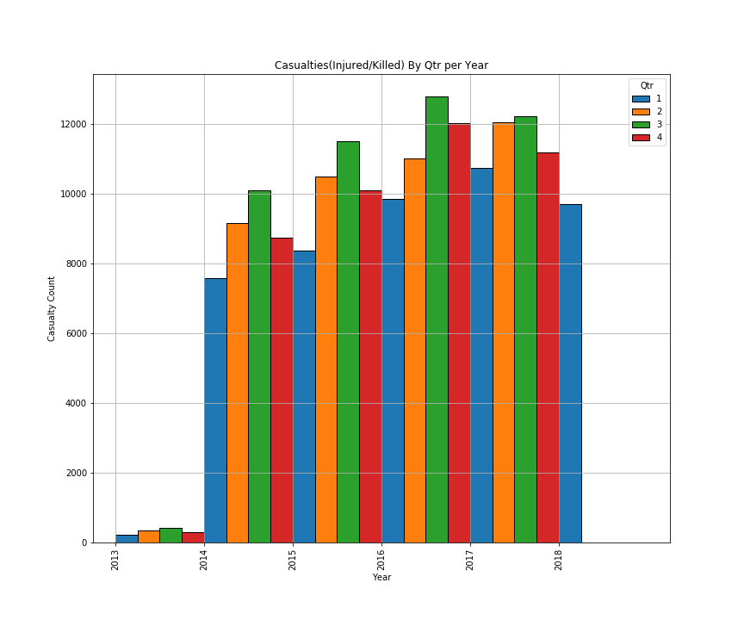
Analyzing State Casualty Data by Quarter for each Year
1st Quarter-Lowest
3rd Quarter- Highest
Trend -increasing every year for each quarter
Summer Months seem to be higher than others
Notes:
The graph represents casualties in the United States for each year that was included in our data. Each year is split into quarters for better analysis. During the first quarter the amount of casualties is lowest, we believe the reason for this is because the 1st quarter include the coldest months of the year in the United States. As we can see during the third quarter each year the amount of casualties over the united states is higher than any other quarter. The third quarter consists of July, August and September, this includes the bulk of the summer season in the United States. We believe that the casualties increase during this time because more people are outside enjoying the weather.

Slide 8
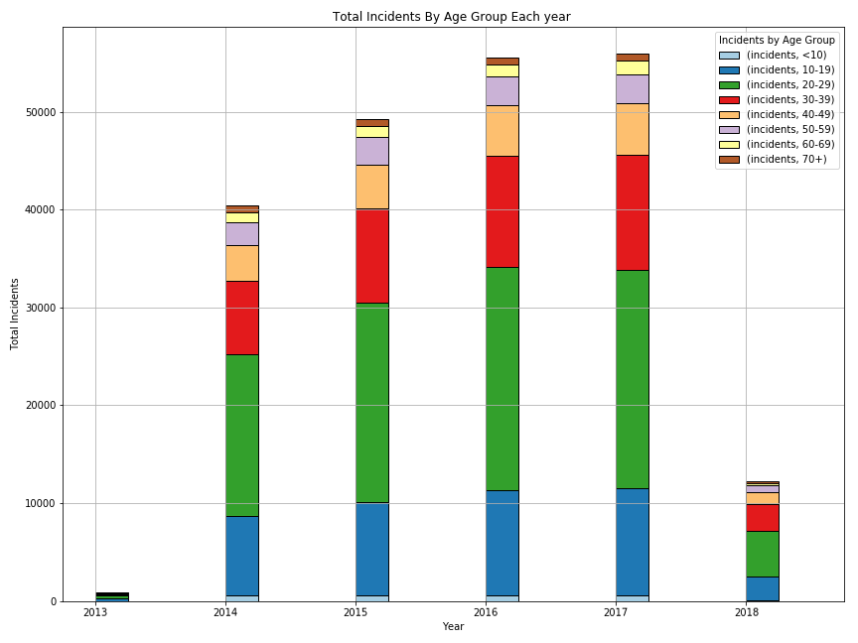
Crimes committed by Demographics by year
Age Group 20-29 highest crime participation and increasing each year.
Age <10 lowest crime participation.
Notes:
The reason we came up with this particular graph was because we were curious to see what age group is more prone to committing the gun violence crime. Our data suggests that people between the ages of 20-29 are doing majority of the casualties related to gun violence, while for obvious reasons ages less than 10 are contributing the least. According to the YOUTH VIOLENCE, GUNS, AND THE ILLICIT-DRUG INDUSTRY article by Alfred Blumstein this age is prone to criminal activities. Some reasoning behind this according to the article is related to stress that this age group deals with, the stress being related to entering the workforce for the first time, graduating college and attempting to pay their bills, relationships etc.

Slide 9
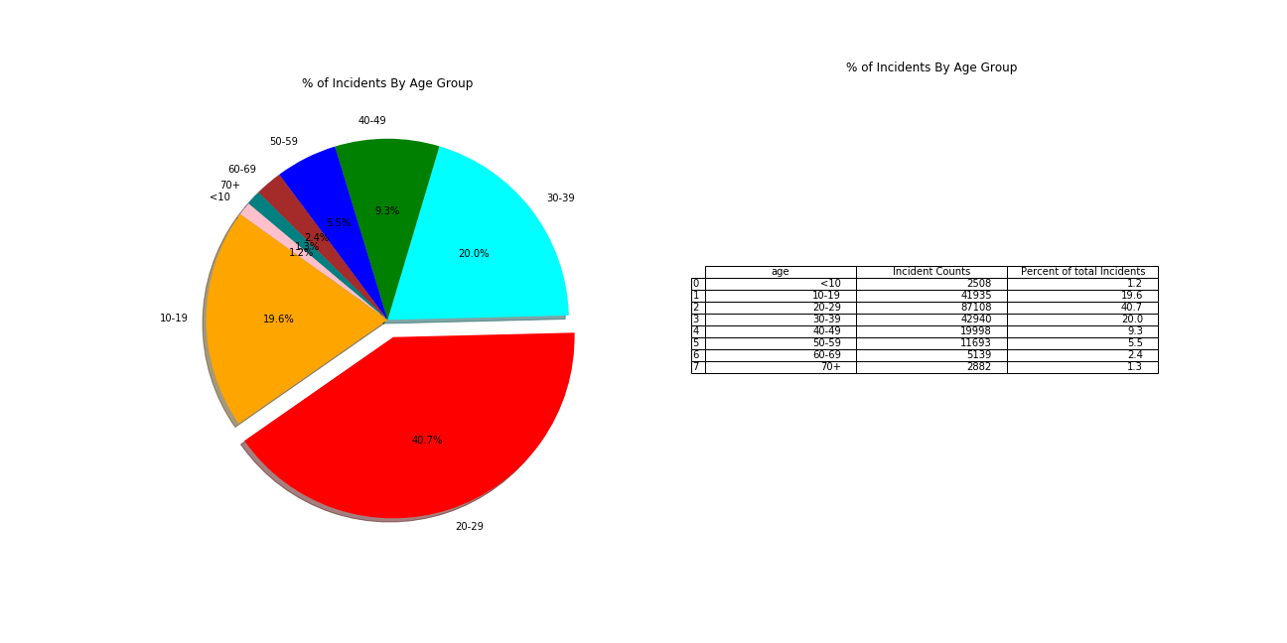
Age Group Crime Participation Percentage 2013-2018
Over 40% of Incidents were committed by people between age group 20-29

Slide 10
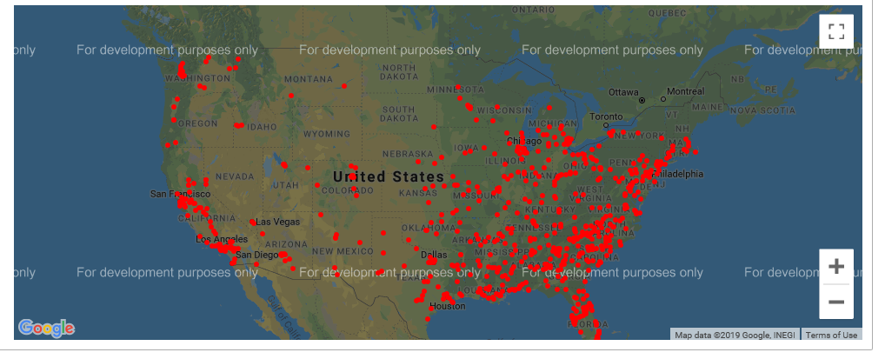
Casualties throughout the United States
Coastal states, densely populated areas see more Casualties/Incidents
Notes:
This visualization was created using a google api. Based on our data this shows that most of the gun violence casualties takes place on the east and west coasts. There are many factors to contribute to this one of them being population density. On the east coast there is less land per state and the amount of people is higher than the mid west states. For California although the state itself is big there are a lot of major cities in the state where the population is crowded and where most of the casualties happen.

Slide 11
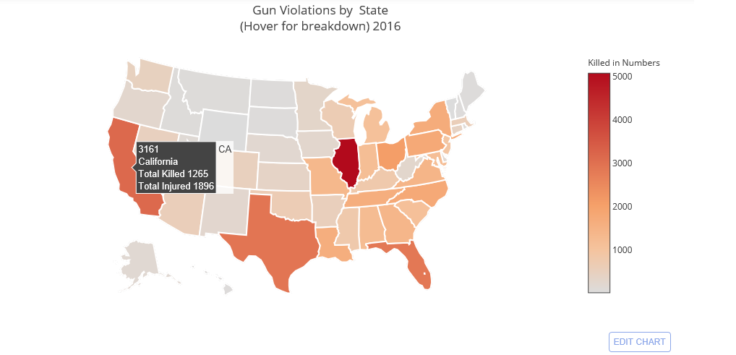
Gun Crime Heat Map - USA

Slide 12
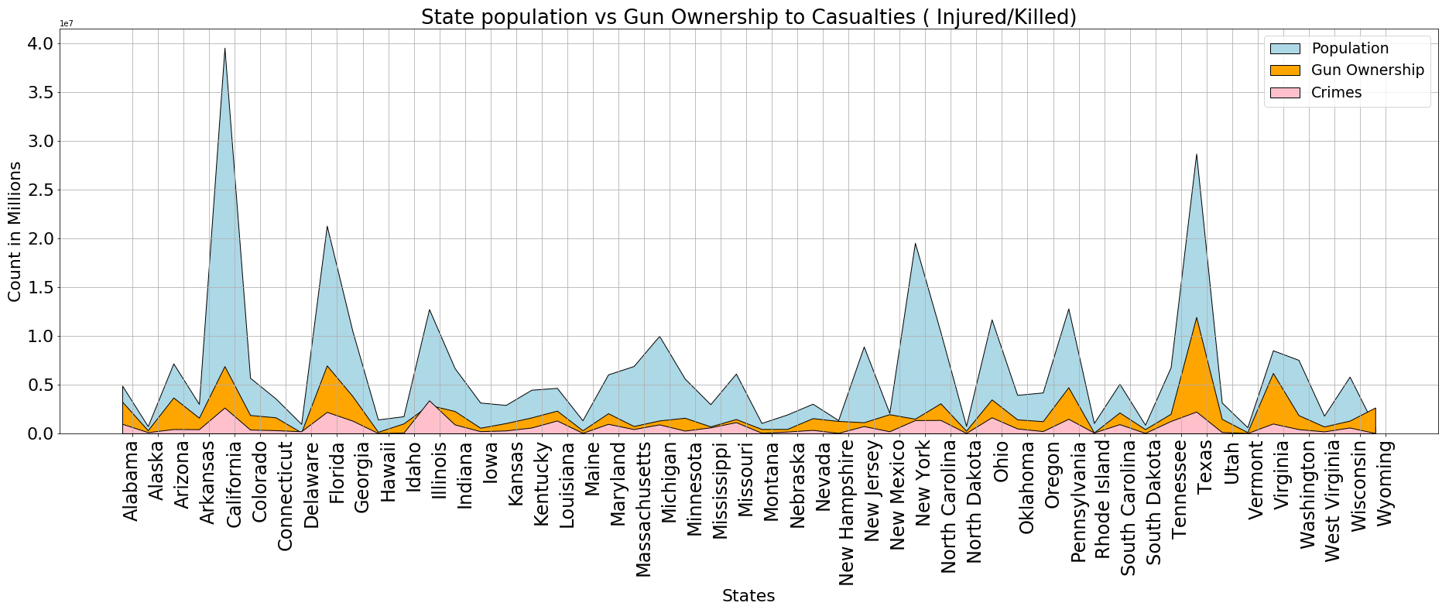
State Population Vs Gun Ownership Vs Crimes
Do more guns mean more gun related crimes ? Is Wyoming an exception?
State with Highest Gun Ownership and less than 1 % Gun related Crime

Slide 13
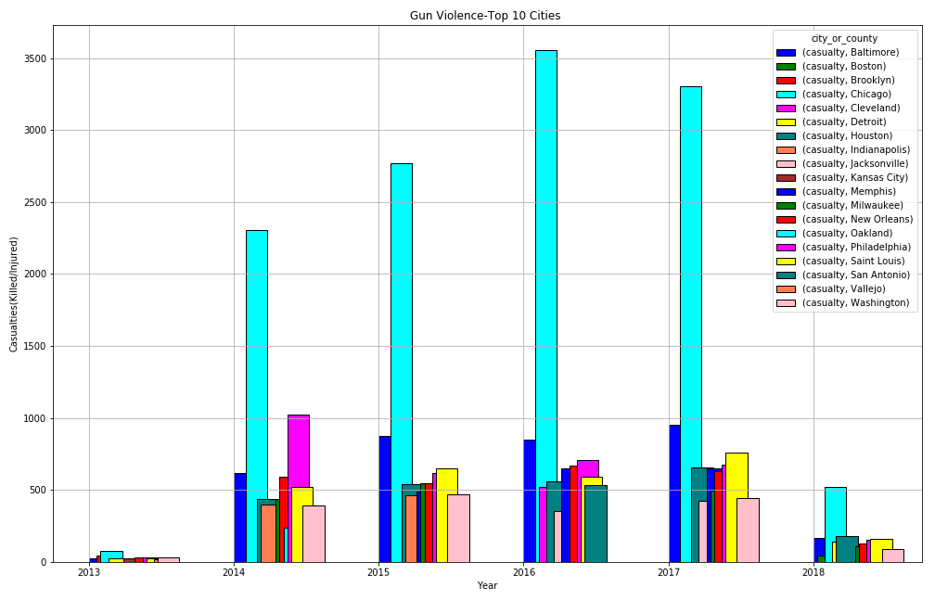
Top 10 Cities with Highest Casualties per Year (2013-2018)- A Comparative View
Chicago Tops the List
Baltimore takes the 2nd Place

Slide 14
Conclusion: Analysis, Trends and Predictions
Gun Violence – Increasing year over year unless checked will be ever growing.
State of Illinois has the highest Incidents/Casualties and 10-15% growth every year.
City of Chicago tops the list in United States for having the highest gun related crimes and it is growing @10-12 % each year.
Youth Groups between ages 20-29 has the highest rate of Incidents each year.
Among the years surveyed for the crimes, the above Age group accounts for 40% of the crimes and the rate is climbing in double digits.
The gun crime rates seems to top at the third quarter of each year and is the lowest in the first quarter.
More guns in a state does not necessarily mean more violence. Wyoming has the highest gun ownership but least crime rate among all states(under one percent).
Gun related incidents are very frequent around the coastal United States both East , West and the Southern United States.

Slide 15
Appendix
DataSource
  Kaggle : https://www.kaggle.com/jameslko/gun-violence-data
  Kaggle : https://www.kaggle.com/lucasvictor/us-state-populations-2018
  Kaggle : https://www.kaggle.com/solorzano/gun-ownership-by-state
Other references:
https://www.axios.com/chicago-gun-violence-murder-rate-statistics-4addeeec-d8d8-4ce7-a26b-81d428c14836.html
YOUTH VIOLENCE, GUNS, AND THE ILLICIT-DRUG INDUSTRY Alfred Blumstein

